Slide 1

Noida Institute of Engineering and Technology, Greater Noida
Mobile Application Development
ACSIOT0401
Unit: III
UI Components and Multimedia
SAVITA YADAV
Assistant Professor
IOT Department
Vatika Jalali
Assistant Professor
IoT Department
4th Semester
(IOT)

Slide 2







Faculty Profile
Responsibilities
Faculty IoT,
Mentor IoT
Research Interests
Digital Image processing,
Machine Learning
Ms. Vatika Jalali
Assistant Professor, IoT
Education
M.Tech CSE, PTU
B.Tech CSE, HPTU
Publications
Research Paper: 4
Work Exp.
NIET, Gr. Noida (September, 2022 to till date)
Worked at Chandigarh University
Ms. Vatika Jalali Mobile Application Development Unit-3

Slide 3
Evaluation Scheme
Sl. No. | Subject Codes | Subject Name | Periods |  |  | Evaluation Scheme |  |  |  | End Semester |  | Total | Credit
 |  |  | L | T | P | CT | TA | TOTAL | PS | TE | PE
1 | AAS0402 | Engineering Mathematics- IV | 3 | 1 | 0 | 30 | 20 | 50 |  | 100 |  | 150 | 4
2 | AASL0401 | Technical Communication | 2 | 1 | 0 | 30 | 20 | 50 |  | 100 |  | 150 | 3
3 | ACSE0403B | Operating Systems | 3 | 0 | 0 | 30 | 20 | 50 |  | 100 |  | 150 | 3
4 | ACSAI0402 | Database Management Systems | 3 | 1 | 0 | 30 | 20 | 50 |  | 100 |  | 150 | 4
5 | ACSIOT0401 | Mobile Application Development | 3 | 0 | 0 | 30 | 20 | 50 |  | 100 |  | 150 | 3
6 | ACSE0404 | Theory of Automata and Formal Languages | 3 | 0 | 0 | 30 | 20 | 50 |  | 100 |  | 150 | 3
7 | ACSE0453B | Operating Systems Lab | 0 | 0 | 2 |  |  |  | 25 |  | 25 | 50 | 1
8 | ACSAI0452 | Database Management Systems Lab | 0 | 0 | 2 |  |  |  | 25 |  | 25 | 50 | 1
9 | ACSIOT0451 | Mobile Application Development Lab | 0 | 0 | 2 |  |  |  | 25 |  | 25 | 50 | 1
10 | ACSE0459 | Mini Project using Open Technology | 0 | 0 | 2 |  |  |  | 50 |  |  | 50 | 1
11 | ANC0402 / ANC0401 | Environmental Science*/ Cyber Security*(Non Credit) | 2 | 0 | 0 | 30 | 20 | 50 |  | 50 |  | 100 | 0
 |  | MOOCs** (For B.Tech. Hons. Degree)
 |  | GRAND TOTAL |  |  |  |  |  |  |  |  |  | 1100 | 24

Slide 4
Syllabus
Course Contents / Syllabus
UNIT-I | Introduction to Mobile Application and Architecture | 8 Hours
Mobile applications, History of mobile application frameworks, Characteristics and types of mobile applications, Achieving quality constraints. Mobile Architecture- Mobile Hardware Architecture: processors used for Mobile and Handheld devices and SoC architecture; Mobile Software Architecture: Real Time Operating systems and Mobile Real Time Operating Systems, SDK’s.
UNIT-II | Android Developing Environment | 6 Hours
Introduction to Android, Android ecosystem, Android SDK and Installation, Layered Architecture of Android, Android API levels (versions & version names), Android Development Tools, Basic Building blocks – Protocols, Activities, Services, Broadcast Receivers & Content providers.
UNIT-III | UI Components and Multimedia | 10 Hours
Fundamental UI design, layout and view types, Interaction with server-side applications – Using Google Maps, GPS and Wi-Fi, Integration with social media applications, Interfacing sensor data with mobile application, Accessing applications hosted in a cloud computing environment. Multimedia Supported audio and video formats, Audio capture, Bluetooth, Animation.

Slide 5
Syllabus
UNIT-IV | Android Application Deployment | 8 Hours
Persisting data using SQLite database, Testing and debugging Android Application, Packaging and Android Application Deployment on device with Windows, Android Permissions. Testing and publishing of Mobile Applications on different app stores.
UNIT-V | iOS and Swift | 8 Hours
Introduction to Objective C, iOS features, UI implementation, Touch frameworks, Data persistence using Core Data and SQLite, Location aware applications using Core Location and Map Kit, integrating calendar and address book with social media application, using Wifi - iPhone marketplace. Swift: Introduction to Swift, Features of swift.

Slide 6
Branch wise Applications
A mobile app is a medium between an IoT device and a mobile phone.
The app works as the primary interface through which we can manage smart things.
Mobile IoT apps supplement and enhance the use of IoT to make it work more efficiently.

Slide 7
Course Objective
This course introduces students to programming technologies, design and development related to mobile applications using android/ iOS.
Course also aims at mobile application development frameworks; mobile architecture, design and engineering issues, techniques, methodologies for mobile application development.

Slide 8


Course Outcomes
Course outcomes : After completion of this course students will be able to
CO 1 | Recall vision, definition, conceptual framework, architecture of mobile applications. | K1
CO 2 | Describe and configure android development environment, tools, and architecture. | K2
CO 3 | Create and implement UI components and multimedia framework, fragments, audio capture, animation, and other activities. | K6
CO 4 | Integrate and interact with server-side applications with testing and deployment of android application. | K3
CO 5 | Analyze iOS and swift features, frameworks, map kit, and social media applications. | K4

Slide 9
CO-PO Mapping
Mapping of Course Outcomes and Program Outcomes:
CO.k | PO1 | PO2 | PO3 | PO4 | PO5 | PO6 | PO7 | PO8 | PO9 | PO10 | PO11 | PO12
ACSIOT0401.1 | 3 | 3 | 1 | 3 | 2 | 1 | 1 | 3 | 1 | 2 | 2 | 2
ACSIOT0401.2 | 3 | 3 | 2 | 3 | 3 | 2 | 3 | 3 | 2 | 2 | 3 | 2
ACSIOT0401.3 | 3 | 3 | 2 | 3 | 3 | 3 | 3 | 3 | 2 | 2 | 3 | 3
ACSIOT0401.4 | 3 | 3 | 2 | 3 | 2 | 1 | 1 | 3 | 1 | 1 | 2 | 2
ACSIOT0401.5 | 3 | 3 | 2 | 3 | 3 | 2 | 3 | 3 | 2 | 2 | 3 | 2
Average | 3 | 3 | 1.8 | 3 | 2.6 | 1.8 | 2.4 | 3 | 1.8 | 1.8 | 2.6 | 2.2
3= High, 2=Medium, 1=Low

Slide 10
Result Analysis
Subject | No. of students | Min Marks | Max Marks | Over all Result
Mobile Application Development | 40 | 30 | 80 | 95%

Slide 11
Ge
End Semester Question paper Templates
General Instructions:
All questions are compulsory. Answers should be brief and to the point.
This Question paper consists of …………pages & …8………questions.
It comprises of three Sections, A, B, and C. You are to attempt all the sections.
Section A -Question No- 1 is objective type questions carrying 1 mark each, Question No- 2 is very short
answer type carrying 2 mark each. You are expected to answer them as directed.
Section B - Question No-3 is Long answer type -I questions with external choice carrying 6 marks each.
You need to attempt any five out of seven questions given.
Section C - Question No. 4-8 are Long answer type –II (within unit choice) questions carrying 10 marks
each. You need to attempt any one part a or b.
Students are instructed to cross the blank sheets before handing over the answer sheet to the invigilator.
No sheet should be left blank. Any written material after a blank sheet will not be evaluated/checked.

Slide 12
 |  | SECTION – A |  | CO
 | Attempt all parts- |  | [10×1=10]
 | 1-a. | Question- | (1)
 | 1-b. | Question- | (1)
 | 1-c. | Question- | (1)
 | 1-d. | Question- | (1)
 | 1-e. | Question- | (1)
 | 1-f. | Question- | (1)
 | 1-g. | Question- | (1)
 | 1-h. | Question- | (1)
 | 1-i. | Question- | (1)
 | 1-j. | Question- | (1)
2. | Attempt all parts- |  | [5×2=10] | CO
 | 2-a. | Question- | (2)
 | 2-b. | Question- | (2)
 | 2-c. | Question- | (2)
 | 2-d. | Question- | (2)
 | 2-e. | Question- | (2)

Slide 13
SECTION – B |  |  |  | CO
3. | Answer any five of the following- |  | [5×6=30]
 | 3-a. | Question- | (6)
 | 3-b. | Question- | (6)
 | 3-c. | Question- | (6)
 | 3-d. | Question- | (6)
 | 3-e. | Question- | (6)
 | 3-f. | Question- | (6)
 | 3-g. | Question- | (6)
SECTION – C |  |  |  | CO
4 | Answer any one of the following- |  | [5×10=50]
 | 4-a. | Question- | (10)
 | 4-b. | Question- | (10)
5. | Answer any one of the following-
 | 5-a. | Question- | (10)
 | 5-b. | Question- | (10)
6. | Answer any one of the following-
 | 6-a. | Question- | (10)
 | 6-b. | Question- | (10)
7. | Answer any one of the following-
 | 7-a. | Question- | (10)
 | 7-b. | Question- | (10)
8. | Answer any one of the following-
 | 8-a. | Question- | (10)
 | 8-b. | Question- | (10)

Slide 14
Prerequisites
Overview of programming language
JAVA and XML.

Slide 15
Brief Introduction about the Subject with videos
Mobile application development is the process of creating software applications that run on a mobile device, and a typical mobile application utilizes a network connection to work with remote computing resources.
Hence, the mobile development process involves creating installable software bundles (code, binaries, assets, etc.) , implementing backend services such as data access with an API, and testing the application on target devices.
https://www.youtube.com/watch?v=bOiCw-ZZlGA
https://www.youtube.com/watch?v=09TeUXjzpKs&t=5270s

Slide 16
Recap of unit 2
Discussed the key concepts of android
Elaborated the features and android platform
Discussed the android SDK and architecture
Understood the installation of Android and using the basics
Know about the Activities, Services, Broadcast Receivers & Content providers.

Slide 17
Unit Contents
Fundamental UI design
Layout and view types
Interaction with server-side applications-using Google Maps, GPS and Wi-Fi
Integration with social media applications
Interfacing sensor data with mobile applications
Accessing applications hosted in a cloud computing environment.
Multimedia Supported audio and video formats
Audio capture
Bluetooth
Animation

Slide 18
Unit Objective
To understand key concepts of UI components.
To know the integration with social media.
To understand the interfacing of sensor data with mobile application
To access the applications hosted in a cloud computing environment
To understand the installation of Android and using the basics
To understand the multimedia interaction with android.

Slide 19
Fundamental UI design
Topic Objective: To understand the concept of UI design fundamentals
UI design, or user interface design, refers to designing visual user interfaces in software or computerized devices.
It’s the overall design, the way in which information is presented, and how your users interact with your website.
Throughout the user interface design process, designers focus on either the look or style in order to achieve seamless, user-friendly, and enjoyable designs.
The sign of a powerful and effective UI design is an interface that streamlines your user through a company’s unique sales funnel like an invisible guide.
It empowers your users to complete goals, leaving them happier, more satisfied and highly engaged.

Slide 20
Fundamental UI design
UI design is short for user interface design. Here are a few UI design fundamentals:
Predictable and seamless elements, such as buttons
Effective navigation, such as clearly labeled icons
Frictionless and invisible interactions
Purposeful and clear tasks or goals
Guided behavior with design patterns, and clear hierarchy and readability
Key features catch the user’s attention

Slide 21
UI screen components
Topic Objective: To understand the different screen components
A typical user interface of an android application consists of action bar and the application content area.
Main Action Bar
View Control
Content Area
Split Action Bar
https://www.tutorialspoint.com/android/android_ui_design.htm

Slide 22
UI screen components
Understanding Screen Components
The basic unit of android application is the activity.
A UI is defined in an xml file.
During compilation, each element in the XML is compiled into equivalent Android GUI class with attributes represented by methods.
View and ViewGroups
An activity is consist of views.
A view is just a widget that appears on the screen.
It could be button e.t.c. One or more views can be grouped together into one GroupView.
Example of ViewGroup includes layouts.
https://www.tutorialspoint.com/android/android_ui_design.htm

Slide 23
7 UI Design Fundamentals
Define your user:- UI design is the link between users and your website.
Familiar UI patterns:- UI patterns create a sense of familiarity and comfort.
Effective communication and feedback:- Keep users informed with visual cues or simple messaging.
Stay consistent:- Consistent UI design elements allows for seamless integrate and navigation.
Visual hierarchy:- Every screen, menu, and page should provide the same visual hierarchy.
Empower your user:- Functional and aesthetically appealing interfaces empower your user.
Keep it simple and purposeful:- Keep your user interface design simple.

Slide 24
DAILY QUIZ 1
Is it possible to have an activity without UI to perform action/actions?
A - Not possible
B - Wrong question
C - Yes, it is possible
D - None of the above
UI is defined in the ……… file
Name the UI screen components.
The UI design hierarchy and individual design elements can be seen using _____
Properties, component tree, layout, terminal

Slide 25
Android Layout and Views
Topic Objective: To understand the concept of Android View
A View is a simple building block of a user interface.
It is a small rectangular box that can be TextView, EditText, or even a button.
It occupies the area on the screen in a rectangular area and is responsible for drawing and event handling.
View is a superclass of all the graphical user interface components.

Slide 26
Android Layout and Views
Why and How to use the View in Android?
Now you might be thinking what is the use of a View.
So, the use of a view is to draw content on the screen of the user’s Android device.
A view can be easily implemented in an Application using the java code.
Its creation is more easy in the XML layout file of the project.
Like, the project for hello world that we had made initially.

Slide 27
Types of Android Views
The available types of view in Android that we can use:-
TextView
EditText
Button
Image Button
Date Picker
RadioButton
CheckBox buttons
Image View

Slide 28
Android View Group
Topic Objective: To understand the concept of View Group
A View Group is a subclass of the ViewClass and can be considered as a superclass of Layouts.
It provides an invisible container to hold the views or layouts.
ViewGroup instances and views work together as a container for Layouts.
To understand in simpler words it can be understood as a special view that can hold other views that are often known as a child view.
Following are certain commonly used subclasses for ViewGroup:
LinearLayout
RelativeLayout
FrameLayout
GridView
ListView

Slide 29
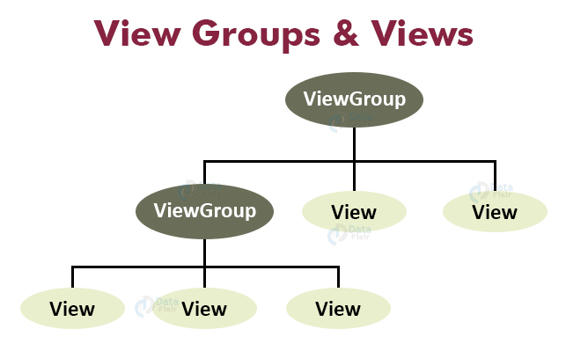
Cont……
Here is how Views and ViewGroups are linked:

Slide 30
DAILY QUIZ 2
What is android view group?
A. Layouts B. Base class of building blocks C. FragmentActivity D. Collection of views and other child views
2. How many main approaches to build GUI of Android app?
A. >=5 B. 2 C. 1 D. 3
Name the examples of views in android.
View is a superclass of all the graphical user interface components. (T/F)

Slide 31
Android Layout
Topic Objective: To understand the concept of Android Layout
Layout basically refers to the arrangement of elements on a page these elements are likely to be images, texts or styles.
These are a part of Android Jetpack.
They define the structure of android user interface in the app, like in an activity.
All elements in the layout are built with the help of Views and ViewGroups.
These layouts can have various widgets like buttons, labels, textboxes, and many others.

Slide 32
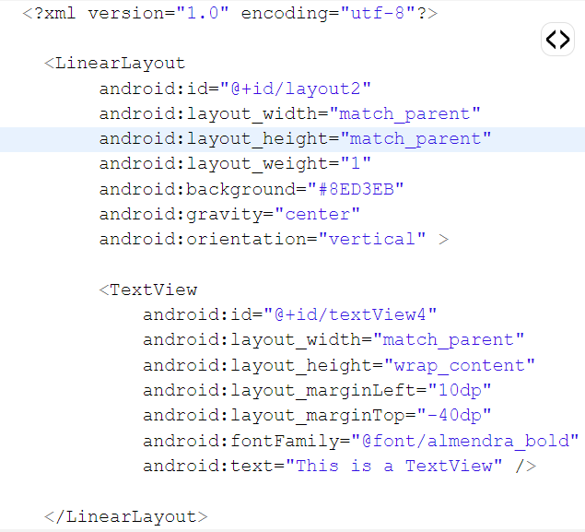
Example of Android Layout

Slide 33
Attributes of Layout in Android
The following are the attributes for customizing a Layout while defining it:
android:id: It uniquely identifies the Android Layout.
android:hint: It shows the hint of what to fill inside the EditText.
android:layout_height: It sets the height of the layout.
android:layout_width: It sets the width of the layout.
android:layout_gravity: It sets the position of the child view.
android:layout_marginTop: It sets the margin of the from the top of the layout.
android:layout_marginBottom: It sets the margin of the from the bottom of the layout.
android:layout_marginLeft: It sets the margin of the from the left of the layout.
android:layout_marginRight: It sets the margin of the from the right of the layout.
android:layout_x: It specifies the x coordinates of the layout.
android:layout_y: It specifies the y coordinates of the layout.

Slide 34
Types of Layouts in Android
Topic Objective: To understand the concept of Android Layout
The types of Layouts in Android, that are as follows:
Linear Layout
Relative Layout
Constraint Layout
Table Layout
Frame Layout
List View
Grid View
Absolute Layout
WebView
ScrollView

Slide 35
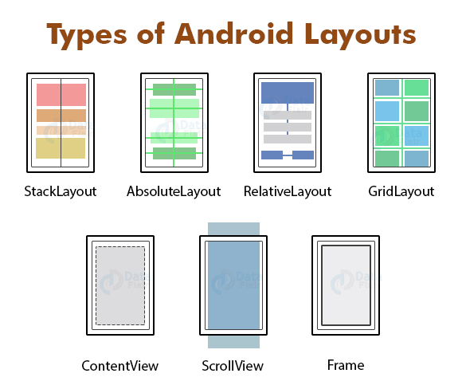
Cont……
Here are the pictorial representations of different layouts-

Slide 36
DAILY QUIZ 3
What is the default layout in android application? A) RelativeLayout B) TableLayout C) LinearLayout D) FrameLayout
2. When a button is clicked, which listener you can use? A) SetOnClickListener B) OnClickListener C) ClickListener D) None of the above.
To display text which control you will use? A) EditText B) TextView C) label D) None of the above.

Slide 37
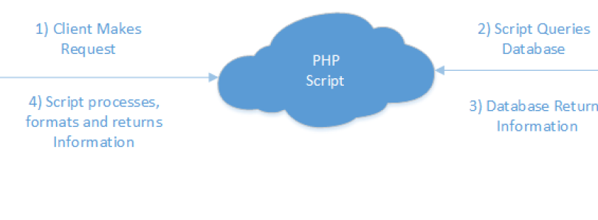
Interaction with server-side applications
Topic Objective: To understand the concept of server side application
The server side of Android application can be developed on any language of your choice i.e. PHP, ASPdotNET, JSP, PYTHON, JAVA etc. You can develop your back-end services using Django (Python) or Laravel (PHP) or some Restful ready framework like JAX-RS (Java) or ExpressJS (Node).

Slide 38
Interaction with server-side applications
The client makes a request using a HTTP POST to a server
The PHP script queries the MYSQL server
The PHP script gets the SQL data
The PHP script puts the data into an array and assigns keys for the values. The script then outputs the data as a JSON array. JSON (JavaScript Object Notation) is a standard for data exchange, and formats the data in a way both humans and computers can easily read.
The app parses the JSON and displays the data.

Slide 39
Interaction with server-side applications
Connecting an android app with an online database and sync it across devices.
Two approaches can be used:
Develop a backend by yourself
Use a mobile backend service(MBAAS)
MBAAS (Mobile Backend is a Service) is the most easy and fastest way to get started in developing a backend using Firebase and Parse.
Firebase helped in rapid prototyping and we could concentrate on ui of the app for hackathon. For production, while testing hit the free tier bandwidth limit which is very less (5 GB) at that time. Recently Firebase got acquired by Google and doing good.
Parse whose free tier bandwidth limit is 2TB which is good. Parse also provided api’s to push notifications, to run cloud code etc. Facebook which acquired Parse planned to shut it down within an year and I am left homeless.
MBAAS can go down anytime and maintaining your app is not their responsibility.

Slide 40
Interaction with server-side applications
web development frameworks to develop a backend of your own without depending upon anyone. The three main frameworks which came into consideration
Django
Node.js
Ruby on Rails
Flask

Slide 41
REST APIs
REST stands for Representational State Transfer. It’s a software architectural style for implementing web services. Web services implemented using the REST architectural style are known as the RESTful web services.
It acts as an interface. The communication between the client and the server happens over HTTP. A REST API takes advantage of the HTTP methodologies to establish communication between the client and the server. REST also enables servers to cache the response that improves the application’s performance.

Slide 42
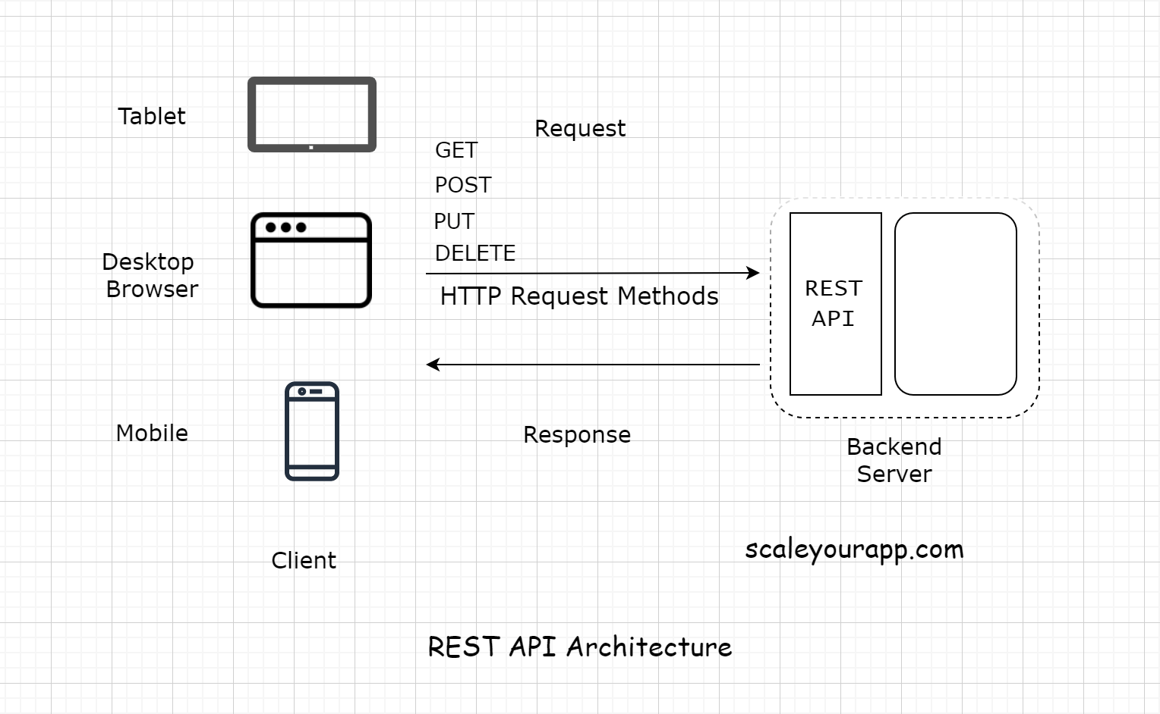
REST APIs
web development frameworks to develop a backend of your own without depending upon anyone. The three main frameworks which came into consideration
Django
Node.js
Ruby on Rails
Flask

Slide 43
REST APIs
The communication between the client and the server is a stateless process that means every communication between the client and the server is like a new one.
There is no information or memory carried over from the previous communications. So, every time a client interacts with the backend, the client has to send the authentication information to it as well. This enables the backend to figure out whether the client is authorized to access the data or not.
When implementing a REST API, the client communicates with the backend endpoints. This entirely decouples the backend and the client code.

Slide 44
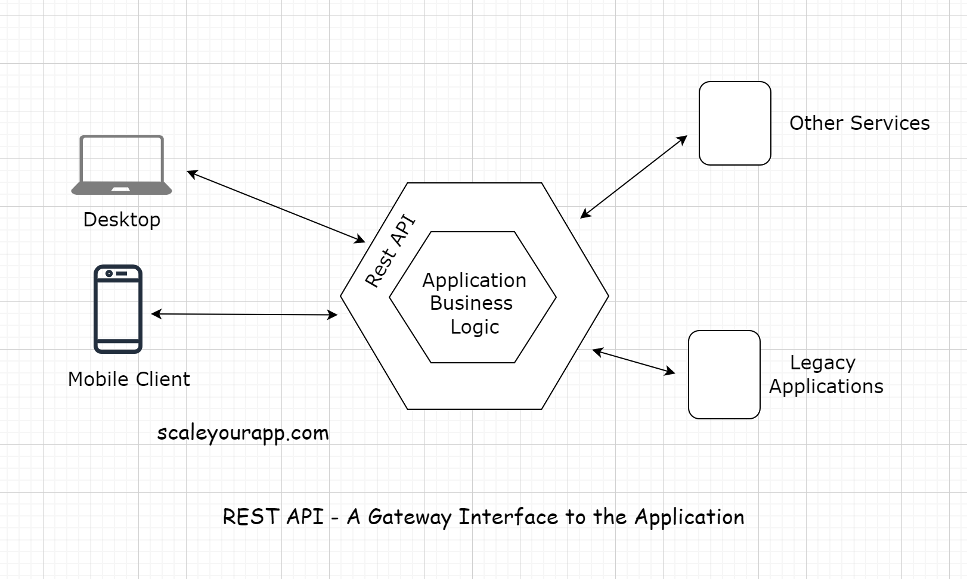
REST APIs

Slide 45
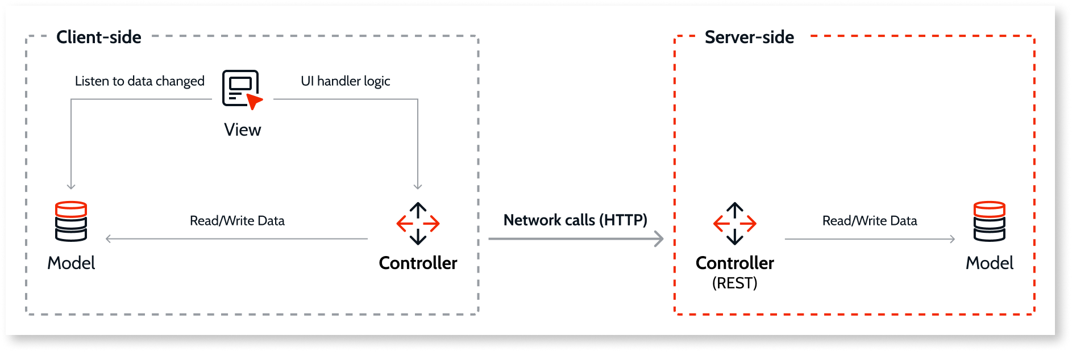
Interaction with server-side applications
Topic Objective: To understand the concept of server side application
In an OutSystems Mobile application, all the communication between the app and the Platform Server is done through REST calls. All the calls to Aggregates/Data Actions and Server Actions in Mobile modules will have REST endpoints generated automatically by the platform.

Slide 46
Interaction with server-side applications
Whenever data is fetched from the server or a Server action needs to run, JavaScript code from the app’s Controller files performs HTTP calls to the generated REST endpoints.
In the case of data fetching, the controller, upon receiving the answer from the contacted REST endpoint, sends the data received to the Model. If this data is being in use by the UI, the View gets alerted and updates it on the screen.

Slide 47

Server-side access control
Access control is done on the server side to make sure no unauthorized accesses are made to the generated REST endpoints.
This access control is done using a secure user token that is sent whenever there’s a call to one of these endpoints.

Slide 48
Adding Google Maps to Traxy
Topic Objective: To understand the concept of Google maps.
The GoogleMaps library provides two options for incorporating maps into your app: (a) as a fragment or
(b) as a view widget (MapView).
The overall steps for implementing both options look very similar, if you know how to implement one, you can implement the other relatively easily. In this section, you are going to implement the first option: showing maps in a fragment. Since Google Maps fragment has all lifecycle functions pre-populated with necessary logic, you don’t have to write them yourself, hence it is much simpler to use Google Maps Fragment than MapView.
Add the library required to use Google Maps
compile 'com.google.android.gms:play-services-maps:17.0.0'

Slide 49
Cont…….
2. Create TripMapsFragment from the Google Maps Fragment template. Android Studio will automatically create several files:
• Kotlin source file TripMapsFragment.kt
• Layout file fragment_trip_maps.xml
• XML resource files google_maps_api.xml for defining string resource google_maps_key. You will find two copies of this file (under app/src/debug and app/src/release)
To conceal the Google Maps API Key, you can remove these two files and define the string resource in your app build.gradle, using a similar technique described in Section 7.3.2. Since we already have an API key for the Places API, the same key can be used for Maps API:
1 buildConfigField "String", "GOOGLE_API_KEY", secretProp['API_KEY’]
2 resValue "string", "google_maps_key", secretProp['API_KEY']

Slide 50
Cont…….
be sure that “string” for resValue is typed in lowercase.
To include the map fragment as the third view in our view pager, you must modify the following files:
• JournalPagerAdapter should now handle three fragments
• JournalPagerFragment the TabLayoutMediator should also handle three tabs.
Rerun your app to make sure the maps shows up correctly the map marker shows up in the correct position.
Let’s move on to adding code to show markers at travel destinations in our journals. Rendering the markers must be performed only after the map and the view model data are completely initialized. Be aware that these two events are asynchronous and we don’t know for sure which one will finish before the order. Each of these events can be captured by their respective observer:
• Upon completion of the map initialization, the closer given by OnMapReadyCallback will run

Slide 51
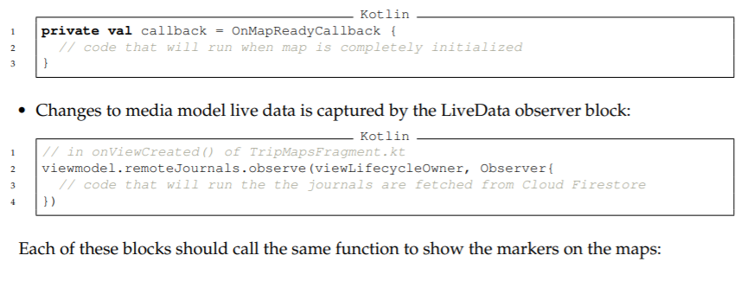
Cont…….

Slide 52
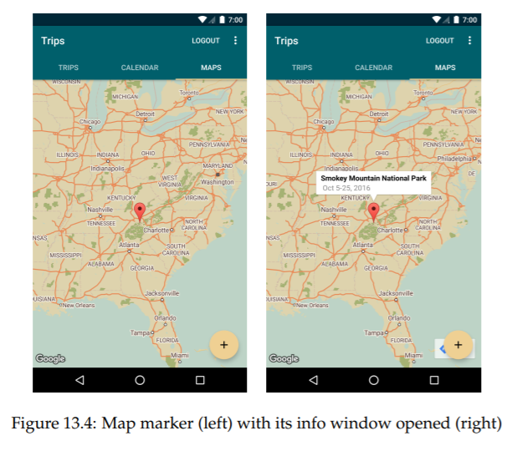
Cont…….

Slide 53
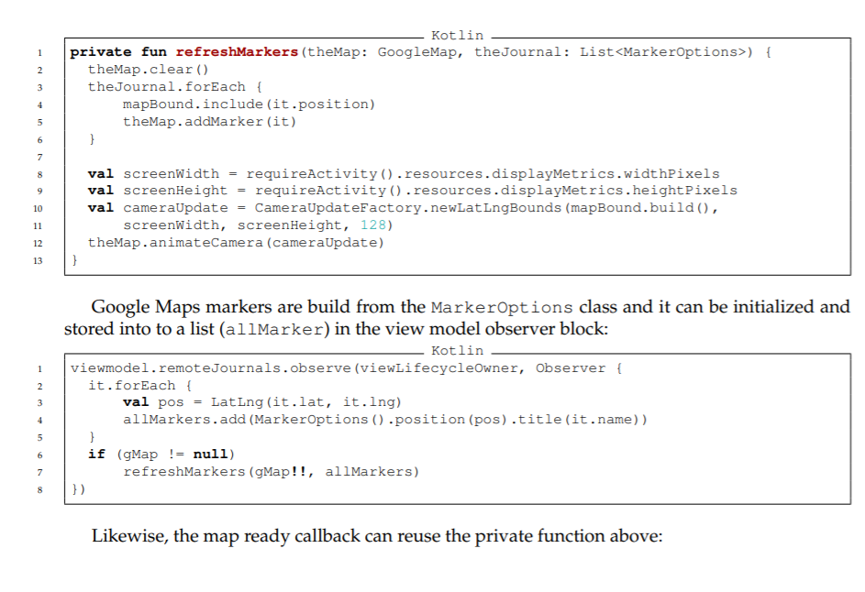
Cont…….

Slide 54
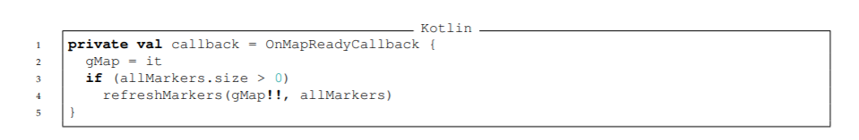
Cont…….

Slide 55
DAILY QUIZ 4
Can we Put Google Maps On My Site Without Using The Google Maps Apis??
Google Maps is a web-based service developed by Google. (T/F)
Road, Satellite, Hybrid, Terrain are types of Google maps or Activity.
Any Object can be draw on the map and attach them to preferred latitude and longitude are known as overlays. (T/F)

Slide 56
How to Build GPS Navigation Into Your App
Topic Objective: To understand the concept of GPS and Wifi.
Maps and navigation are essential components of many apps.
You can find the best restaurant around the corner, track where you wandered on your latest hike or view your travel pictures on a map with your destinations.
Of course, they are also crucial in the automotive industry – just imagine a modern car without map and navigation capabilities.

Slide 57
How to Build GPS Navigation Into Your App
By following this step-by-step guide, you will learn how to create a location based app:
Step 1: Add the AppMap to Your Application
Step 2: Choose Your Map Provider
Step 3: Design Your AppMap
Step 4: Show User Position
Step 5: Add Searchable Address Field
Step 6: Set Up the Navigation
Step 7: Display Routing Information

Slide 58
DAILY QUIZ 5
Which element is used to display Google map in your UI.
A) View B) Map C) MapView D) None of the above.
2. For using Google map which permission you will specify in the AndroidManifest.xml?
A)USEMAP B) USE_GOOGLE_MAP C) INTERNET D) None of the above.
3. To enable zoom control on google map, Which method of MapView is used? Suppose that instance of MapView is mapView. A) ZoomControls.Enabled=true. B) mapView.setBuiltInZoomControls(true); C) mapView= ZoomControls(true); D) None of the above.

Slide 59
Integration with social media applications
Topic Objective: To understand the concept of social media applications with android.
Reasons to integrate social media
Social media brings people together, gives them an ability to communicate at any time and from any place.
People go shopping on social media, make choices and use different services.
This is why integrating social media in your application is a great way to attract audience, make onboarding easier and make your application more recognizable.

Slide 60
6 ways to integrate social media into your website
Onboarding and login
Social proof
Social sharing buttons
Open graph
Embedded social media videos
Social media commenting

Slide 61
How to integrate Facebook into your mobile app
To integrate Facebook into your mobile app
Integrating the Facebook SDK
Facebook Login SDK
Sharing
Photos & videos
Multimedia

Slide 62
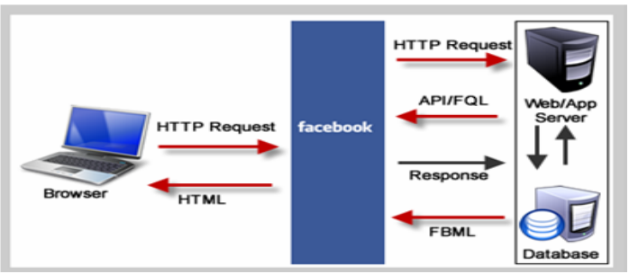
How to integrate Instagram into your Android mobile app
To integrate Instagram into your Android mobile app
Authentication
Sharing

Slide 63
DAILY QUIZ 6
Which method is invoked first when the app is launched?
onCreate()
setOnClickListener()
getId()
2. Graph API — Get data in and out of Facebook's social graph, query data, post stories, upload photos and perform other tasks. (T/F)
3. Increase engagement with your app by using Mobile App Engagement Ads (T/F)
4. Is Instagram free on Android?

Slide 64
Interfacing sensor data with mobile application
Topic Objective: To understand the concept of interfacing sensor data with android app
Most Android-powered devices have built-in sensors that measure motion, orientation, and various environmental conditions.
These sensors are capable of providing raw data with high precision and accuracy, and are useful if you want to monitor three-dimensional device movement or positioning, or you want to monitor changes in the ambient environment near a device.
For example, a game might track readings from a device's gravity sensor to infer complex user gestures and motions, such as tilt, shake, rotation, or swing.
Likewise, a weather application might use a device's temperature sensor and humidity sensor to calculate and report the dewpoint, or a travel application might use the geomagnetic field sensor and accelerometer to report a compass bearing.

Slide 65
Sensors in Android
The Android platform supports three broad categories of sensors:
Motion sensors
These sensors measure acceleration forces and rotational forces along three axes. This category includes accelerometers, gravity sensors, gyroscopes, and rotational vector sensors.
Environmental sensors
These sensors measure various environmental parameters, such as ambient air temperature and pressure, illumination, and humidity. This category includes barometers, photometers, and thermometers.
Position sensors
These sensors measure the physical position of a device. This category includes orientation sensors and magnetometers.

Slide 66
Sensors in Android
You can access sensors available on the device and acquire raw sensor data by using the Android sensor framework. The sensor framework provides several classes and interfaces that help you perform a wide variety of sensor-related tasks. For example, you can use the sensor framework to do the following:
Determine which sensors are available on a device.
Determine an individual sensor's capabilities, such as its maximum range, manufacturer, power requirements, and resolution.
Acquire raw sensor data and define the minimum rate at which you acquire sensor data.
Register and unregister sensor event listeners that monitor sensor changes.
This topic provides an overview of the sensors that are available on the Android platform. It also provides an introduction to the sensor framework.

Slide 67
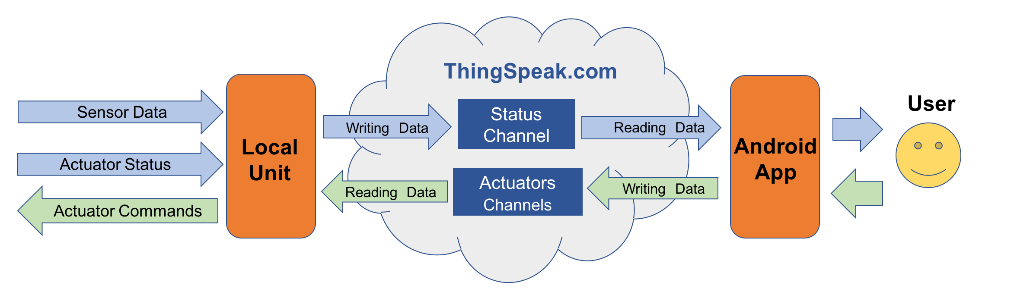
Accessing applications hosted in a cloud computing environment
Topic Objective: To understand the accessing of android app in cloud

Slide 68
Cont…….
The "Center of our IoT project" will be the ThingSpeak.com. The local unit (UNO/ESP-01) will capture data from sensors and actuator status, send them to the Internet, "writing" on a specific ThingSpeak.com Status Channel. The local unit will also receive data from the internet, "reading" them from specific ThingSpeak Actuator Channels.
An Android App will be also be reading those data from the ThingSpeak.com Status Channel and displaying them for the user. Same way, the user, based on that status info, can send commands to actuators, writing them on ThingSpeak Actuator Channels (See the above Block diagram to better understand the flow of data).

Slide 69
DAILY QUIZ 7
Name the sensor that measure acceleration forces and rotational forces along three axes.
Metadata: Enter information about channel data, including JSON, XML, or CSV data. (T/F)
Write API Key is used for ……………………… in Thingspeak.
Which view can be used to add widgets (Public/Private)

Slide 70
Multimedia Supported audio formats
Topic Objective: To understand the concept of multimedia, animation with android
Format | Encoder | Decoder | Details | File Types Container Formats
AAC LC | YES | YES | Support for mono/stereo/5.0/5.1 content with standard sampling rates from 8 to 48 kHz. | • 3GPP (.3gp) • MPEG-4 (.mp4, .m4a) • ADTS raw AAC (.aac, decode in Android 3.1+, encode in Android 4.0+, ADIF not supported) • MPEG-TS (.ts, not seekable, Android 3.0+)
HE-AACv1 (AAC+) | Android 4.1+ | YES
HE-AACv2 (enhanced AAC+) |  | YES | Support for stereo/5.0/5.1 content with standard sampling rates from 8 to 48 kHz.
xHE-AAC |  | Android 9+ | Support for up to 8ch content with standard sampling rates from 8 to 48 kHz
AAC ELD (enhanced low delay AAC) | Android 4.1+ | Android 4.1+ | Support for mono/stereo content with standard sampling rates from 16 to 48 kHz
AMR-NB | YES | YES | 4.75 to 12.2 kbps sampled @ 8kHz | • 3GPP (.3gp) • AMR (.amr)

Slide 71
Multimedia Supported audio formats
AMR-WB | YES | YES | 9 rates from 6.60 kbit/s to 23.85 kbit/s sampled @ 16kHz
FLAC | Android 4.1+ | Android 3.1+ | Mono/Stereo (no multichannel). Sample rates up to 48 kHz (but up to 44.1 kHz is recommended on devices with 44.1 kHz output, as the 48 to 44.1 kHz downsampler does not include a low-pass filter). 16-bit recommended; no dither applied for 24-bit. | • FLAC (.flac) • MPEG-4 (.mp4, .m4a, Android 10+)
MIDI |  | YES | MIDI Type 0 and 1. DLS Version 1 and 2. XMF and Mobile XMF. Support for ringtone formats RTTTL/RTX, OTA, and iMelody | • Type 0 and 1 (.mid, .xmf, .mxmf) • RTTTL/RTX (.rtttl, .rtx) • OTA (.ota) • iMelody (.imy)
MP3 |  | YES | Mono/Stereo 8-320Kbps constant (CBR) or variable bit-rate (VBR) | • MP3 (.mp3) • MPEG-4 (.mp4, .m4a, Android 10+) • Matroska (.mkv, Android 10+)
Opus | Android 10+ | Android 5.0+ |  | • Ogg (.ogg) • Matroska (.mkv)
PCM/WAVE | Android 4.1+ | YES | 8- and 16-bit linear PCM (rates up to limit of hardware). Sampling rates for raw PCM recordings at 8000, 16000 and 44100 Hz. | WAVE (.wav)
Vorbis |  | YES |  | • Ogg (.ogg) • Matroska (.mkv, Android 4.0+) • MPEG-4 (.mp4, .m4a, Android 10+)

Slide 72
Multimedia Supported video formats
Format | Encoder | Decoder | Details | File Types Container Formats
H.263 | YES | YES | Support for H.263 is optional in Android 7.0+ | • 3GPP (.3gp) • MPEG-4 (.mp4) • Matroska (.mkv)
H.264 AVC Baseline Profile (BP) | Android 3.0+ | YES |  | • 3GPP (.3gp) • MPEG-4 (.mp4) • MPEG-TS (.ts, AAC audio only, not seekable, Android 3.0+) • Matroska (.mkv)
H.264 AVC Main Profile (MP) | Android 6.0+ | YES | The decoder is required, the encoder is recommended.
H.265 HEVC |  | Android 5.0+ | Main Profile Level 3 for mobile devices and Main Profile Level 4.1 for Android TV | • MPEG-4 (.mp4) • Matroska (.mkv)

Slide 73
Multimedia Supported video formats
MPEG-4 SP |  | YES |  | 3GPP (.3gp)
VP8 | Android 4.3+ | Android 2.3.3+ | Streamable only in Android 4.0 and above | • WebM (.webm) • Matroska (.mkv, Android 4.0+)
VP9 |  | Android 4.4+ |  | • WebM (.webm) • Matroska (.mkv)
AV1 |  | Android 10+ | The decoder is optional. | • MPEG-4 (.mp4) • Matroska (.mkv)

Slide 74
Audio capture
The AudioPlaybackCapture API was introduced in Android 10.
This API gives apps the ability to copy the audio being played by other apps.
This feature is the analog of screen capture, but for audio.
The primary use case is for streaming apps that want to capture the audio being played by games.
Note that the AudioPlaybackCapture API does not affect the latency of the app whose audio is being captured.

Slide 75
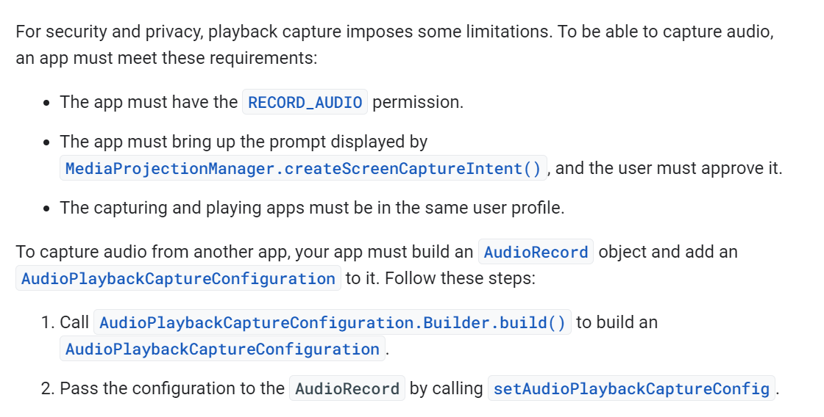
Building a capture app

Slide 76
DAILY QUIZ 8
…………. refers to content that uses a combination of different content forms.
Name the supported file formats for video capture.
When was AudioPlaybackCapture introduced in android.
setAudioEncoder() is used for …….

Slide 77
Android Bluetooth
Bluetooth is a way to exchange data with other devices wirelessly. Android provides Bluetooth API to perform several tasks such as:
scan bluetooth devices
connect and transfer data from and to other devices
manage multiple connections etc.

Slide 78
Android Bluetooth API
The android.bluetooth package provides a lot of interfaces classes to work with bluetooth such as:
BluetoothAdapter
BluetoothDevice
BluetoothSocket
BluetoothServerSocket
BluetoothClass
BluetoothProfile
BluetoothProfile.ServiceListener
BluetoothHeadset
BluetoothA2dp
BluetoothHealth
BluetoothHealthCallback
BluetoothHealthAppConfiguration

Slide 79
Animation in Android
Animation is the process of adding a motion effect to any view, image, or text.
With the help of an animation, you can add motion or can change the shape of a specific view.
Animation in Android is generally used to give your UI a rich look and feel.
The animations are basically of three types as follows:
Property Animation
View Animation
Drawable Animation

Slide 80
Animation in Android
1. Property Animation
Property Animation is one of the robust frameworks which allows animating almost everything. This is one of the powerful and flexible animations which was introduced in Android 3.0. Property animation can be used to add any animation in the CheckBox, RadioButtons, and widgets other than any view.
2. View Animation
View Animation can be used to add animation to a specific view to perform tweened animation on views. Tweened animation calculates animation information such as size, rotation, start point, and endpoint. These animations are slower and less flexible. An example of View animation can be used if we want to expand a specific layout in that place we can use View Animation. The example of View Animation can be seen in Expandable RecyclerView.
3. Drawable Animation
Drawable Animation is used if you want to animate one image over another. The simple way to understand is to animate drawable is to load the series of drawable one after another to create an animation. A simple example of drawable animation can be seen in many apps Splash screen on apps logo animation.

Slide 81
Important Methods of Animation
startAnimation()
This method will start the animation.
clearAnimation()
This method will clear the animation running on a specific view.

Slide 82
Animation in Android
Steps to add animations:-
Step 1: Create a New Project
Step 2: Working with the strings.xml file Step 3: Add google repository in the build.gradle file of the application project if by default it is not there
Step 4: Working with the activity_main.xml file
Step 5: Create 6 different types of animation for ImageView
Step 6: Working with the MainActivity.java file

Slide 83
DAILY QUIZ 9
Android provides Bluetooth API to perform what kind of operations.
Scan for other Bluetooth devices
Get a list of paired devices
Connect to other devices through service discovery
All of these
2. ACTION_REQUEST_DISCOVERABLE is used to ……..
3. Which method sets the data source of audio/video file (setDataSource(FileDescriptor fd) / selectTrack(int index))
4. Which method is used to set the orientation of the screen to vertical or landscape. (EXTRA_SCREEN_ORIENTATION / SCREEN_ORIENTATION)

Slide 84
WEEKLY ASSIGNMENT
Write the android activity to connect your location and show the navigations.
Explain the layouts and its types.
Interface any one sensor with android application.
Write the syntax for adding marker for customizing google map.
Write a program to integrate audio with android.
Write a program to interface a sensor and read the data from cloud.

Slide 85
TOPIC LINKS
https://www.tutorialspoint.com/android/android_audio_capture.htm
https://developer.android.com/codelabs/android-training-provide-user-navigation?index=..%2F..%2Fandroid-training#3
https://www.javatpoint.com/android-ui-widgets-tutorial

Slide 86
MCQ
1. What is the life cycle of services in android?
A - onCreate()−>onStartCommand()−>onDestory()
B - onRecieve()
C - final()
D - Service life cycle is same as activity life cycle.
2. What is the 9 patch tool in android?
A - Using with tool, we can redraw images in 9 sections.
B - image extension tool
C - image editable tool
D - Device features

Slide 87
MCQ
3. Which element is used to display Google map in your UI. A) View B) Map C) MapView D) None of the above.
4. For using Google map which permission you will specify in the AndroidManifest.xml? A) USEMAP B) USE_GOOGLE_MAP C) INTERNET D) None of the above.

Slide 88
MCQ
5. What is geocoding? A) Geocoding is the act of converting an address into its coordinates (latitude and longitude). B) Geocoding converts a pair of location coordinates into an address. C) Geocoding means geographical coding. D) None of the above.
6. How will you add marker on map? A) Directly use draw method. B) You cannot add marker on the map. C) Implement an Overlay class and override the draw() method. D) None of the above.

Slide 89
MCQ
7. What are the different location provider are available that you can use to obtain lacation data? A) LocationManager.GPS_PROVIDER B) LocationManager.NETWORK_PROVIDER C) LocationManager.PASSIVE_PROVIDER D) All of the above.
8. Which of the following is the parent class of Activity?
A) context
B) object
C) contextThemeWrapper
D) None of the above

Slide 90
MCQ
9. Which of the following is the parent class of service?
A) context
B) object
C) contextThemeWrapper
D) contextWrapper
10. Which of the following method is used by services to clean up any services?
A) onStop() method
B) stopService() method
C) onDestroy() method
D) stopSelf() method

Slide 91
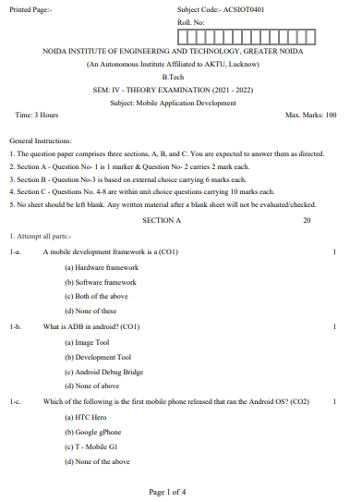
Old University Exam Question Paper

Slide 92
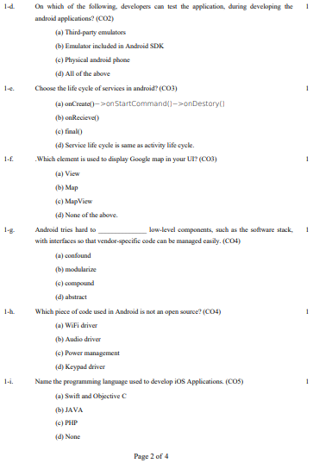
Old University Exam Question Paper

Slide 93
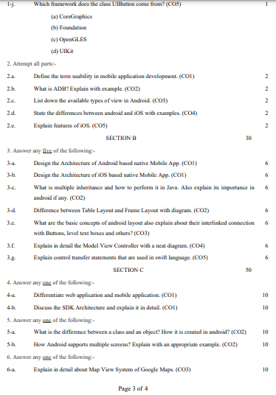
Old University Exam Question Paper

Slide 94
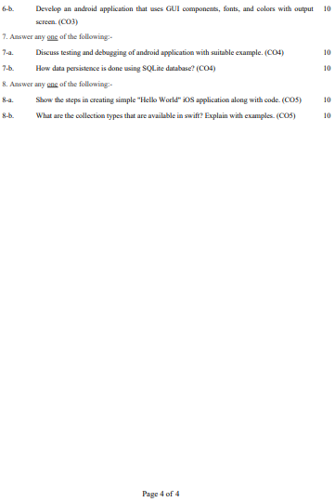
Old University Exam Question Paper

Slide 95
Expected Questions
What are touch events and gestures?
State the importance of double tap?
Explain in detail the importance of integration of Social media Application and
GPS in Mobile Application?
4. Explain in detail the multimedia and Web Access Capabilities in Design of Mobile Application?
5. Write the android activity to connect your location and show the navigations.
Explain the layouts and its types.
Interface any one sensor with android application.
Write the syntax for adding marker for customizing google map.
Write a program to integrate audio with android.
Write a program to interface a sensor and read the data from cloud.

Slide 96
Recap/Summary
Discussed about the key concepts of UI components.
Discussed about the integration with social media.
Understood the interfacing of sensor data with mobile application
Accessed the applications hosted in a cloud computing environment
Understood the installation of Android and using the basics
Understood the multimedia interaction with android.

Slide 97
Noida Institute of Engineering and Technology, Greater Noida
THANK YOU !!

